Slide 1

6502 Debugger
Haley Whitman
Frazer Bayley
Alison Legge
Jeremy Brennan
Abdualziz AL-Heidous
CIS 422 – Dr. Faulk

Slide 2
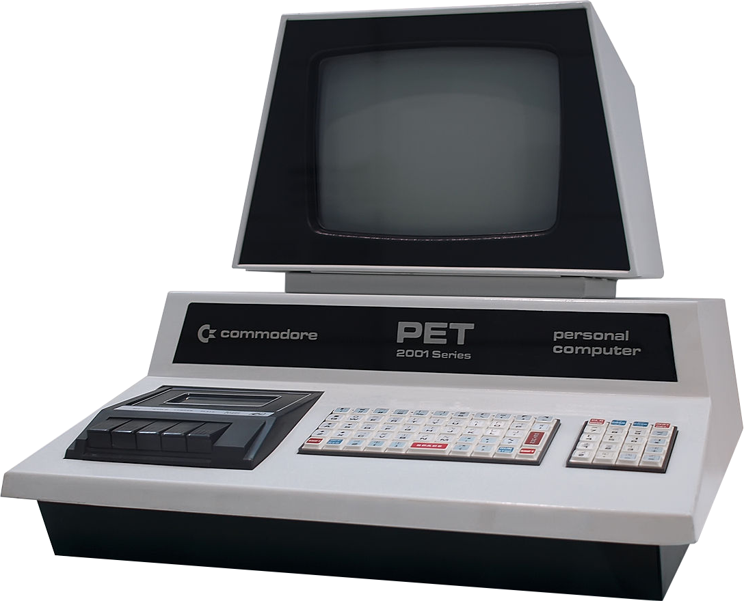
Background
Project is split into two deliverable parts
MOS Technology 6502 Processor
Debugging Interface for 6502 Assembly
Requirements for 6502 Processor
Accurately emulate the behavior of a 6502 processor.
Allow for third-party control of the processor.
Requirements for the debugging interface
1. Allow for a user to input 6502 assembly
2. Allow for the user to view the results, and step through their inputted program.

Slide 3
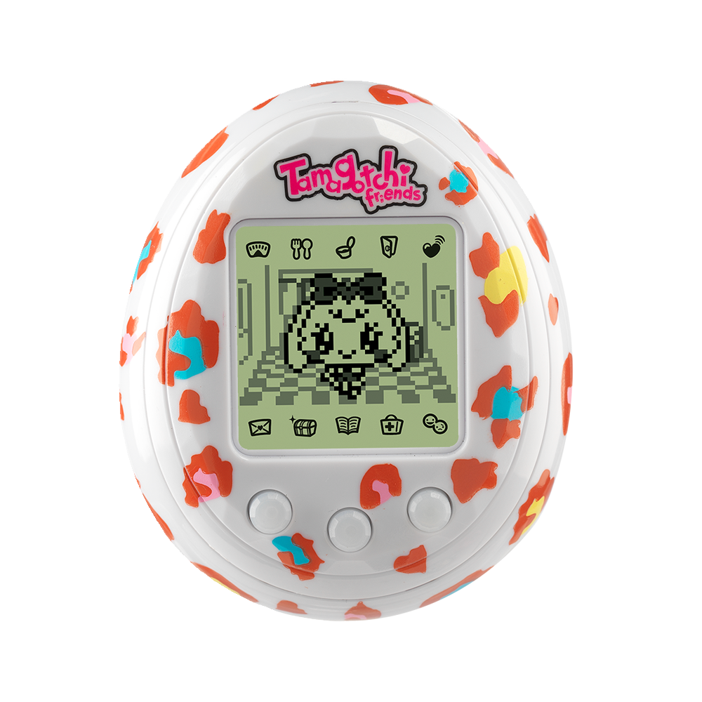
Project Plan
Followed an iterative design, split between
Creating the processor.
Creating the debugging interface.
We created the module design for the processor from Synertek and MOS Technology’s 6502 Programming/Hardware manual.
We followed customer requests and typical debugging use-cases to design the debugging interface. Our documentation focused much more heavily on the debugging interface.

Slide 4
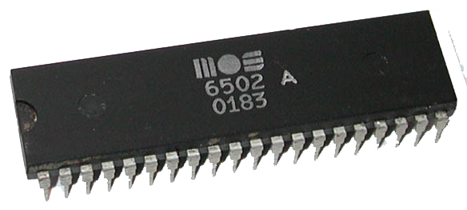
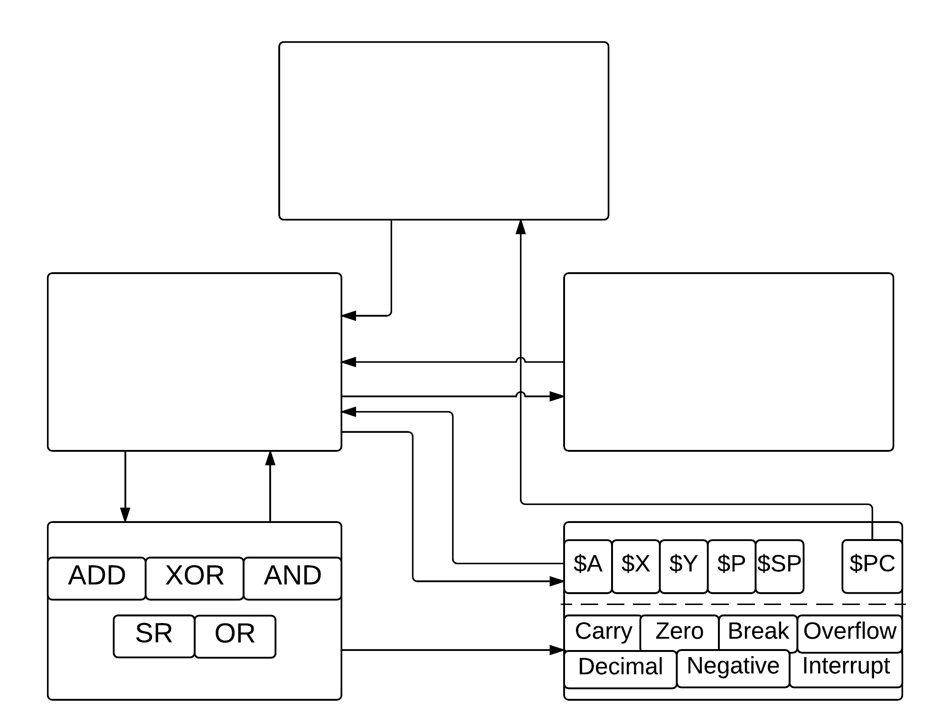
Central Processing Unit (CPU)
Processor Design
Allows control of processor by third-party applications. Decodes current instruction.
Fairly typical design specification
Follows original dataflow of 6502 processor
Instructions
Memory
1-to-1 mapping of 156 standard 6502 instructions.
Contains read/writes of standard 6502 memory. (16Kb of memory)
Arithmetic Logical Unit (ALU)
Registers

Slide 5
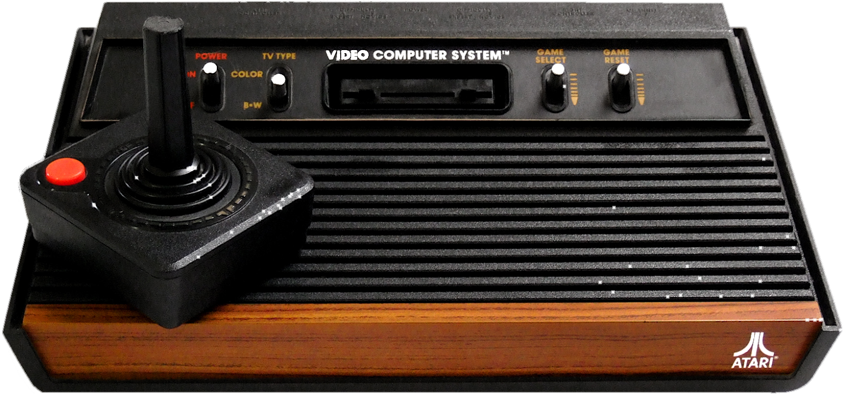
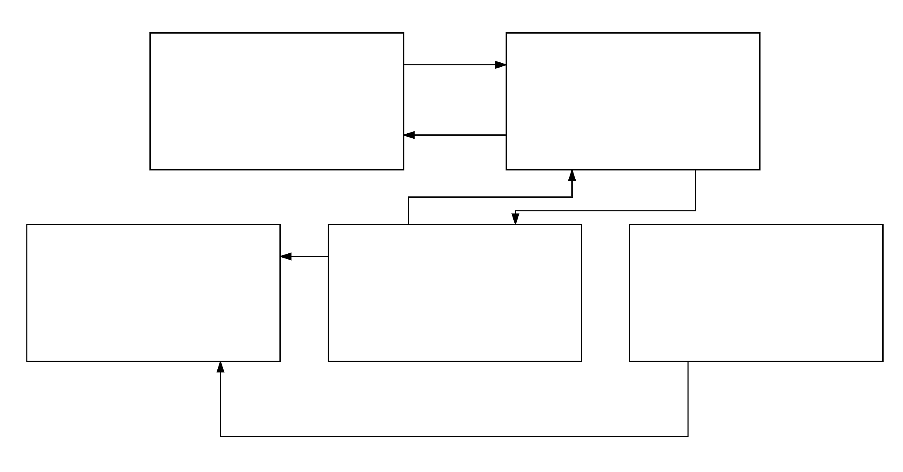
Debugging Design
GUI for Debugger
Debugger Backend
All frames and viewing panels
Supports viewing, and accesses the processor interface
Fairly typical debugging interface,
modeled after more retro-based debuggers for processors such as the Gameboy, where analyzing memory output is helpful.
Has to easily allow for further features.
Written completely separate from the processor
Assembler
Databank
Converts assembly into binary code
Parses user input and handles user errors
Contains mapping of assembly to binary opcode
Import

Slide 6
Application

